Slide 1
Contrarian Investor Virtual Conference
Mon, April 20, 2020
Maj Soueidan
Co-Founder, GeoInvesting, LLC
geoinvesting.com
Twitter: @majgeoinvesting
maj@geoinvesting.com

Slide 2
About Me
Maj Soueidan - Co-Founder of GeoInvesting, Premium Investment Research
Full-Time Investor - ~30 years
Long Tier One Quality Microcaps
Short Fraud
**Disclaimer at end of presentation
Contrarian Investor Virtual Conference | Mon, April 20, 2020

Slide 3
Intouch Insight (INXSF) Quick Pitch
Customer experience management/audit compliance
High recurring revenue
Price could increase several-fold over the next few years to over $3.00 vs current price of $0.26
Shares have gotten crushed due to uncertainty from COVID-19
Prior to COVID-19, business had just reached an inflection point
Long-term investors should be handsomely rewarded
Early in my DD, but like what I have learned so far
Disclosure: Long INXSF
Contrarian Investor Virtual Conference | Mon, April 20, 2020

Slide 4
INXSF Profile
$0.26
$22.5M Shares Outstanding (minimal dilution)
Market Cap: $6M
Location: Ontario, Canada
Founded in 1992
Public for 17 years
CEO: Cameron James Watt
Insider Ownership: ~30%
Contrarian Investor Virtual Conference | Mon, April 20, 2020

Slide 5
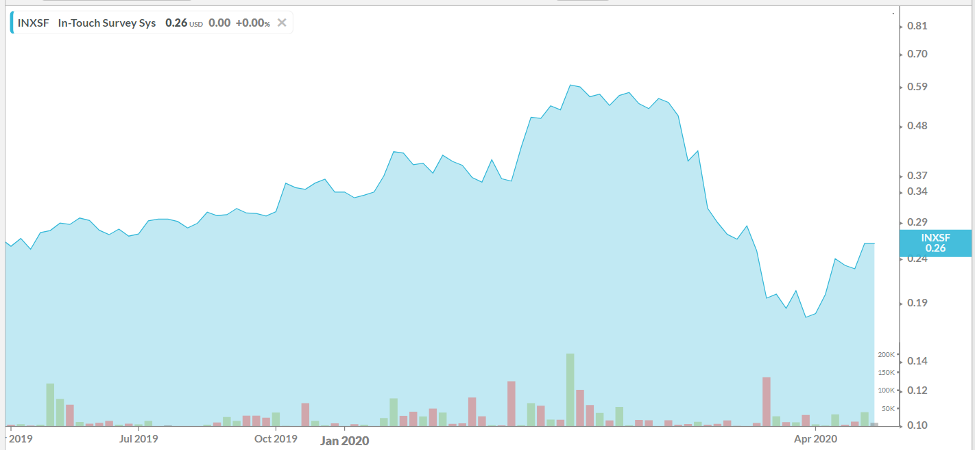
INXSF Chart
Contrarian Investor Virtual Conference | Mon, April 20, 2020

Slide 6
Business At A Glance
What? Capture information from various touch points
Why? To improve customer service / increase sales, improve business processes and comply with regulations
Data Analysis
Contrarian Investor Virtual Conference | Mon, April 20, 2020

Slide 7
Business At A Glance – Recurring Customer Experience Services (Non-Software)
Mystery shoppers hired to visit Client locations to deliver feedback on customer experience
Contrarian Investor Virtual Conference | Mon, April 20, 2020

Slide 8
Business At A Glance – Recurring Inspection Audit Services (Non-Software)
Hired to carry out operation inspection services
Field Audit Solutions - On-site visits
Brand Messaging
Inventory and pricing
Health and Safety
Contrarian Investor Virtual Conference | Mon, April 20, 2020

Slide 9
Business At A Glance – Recurring Compliance Audit Services
Hired to carry out on-site visits regulatory compliance and inspection services
Field Audit Solutions
Age verification (Alcohol and tobacco compliance)
Health and Safety
Educational Testing
PDMA (Prescription drug and marketing act)
Contrarian Investor Virtual Conference | Mon, April 20, 2020

Slide 10
Business At A Glance – Recurring Legacy Software
Online Survey - IntouchSurvey
Event Software - “IntouchCapture”, Surveys and forms at events (SaaS)
Mobile Forms - “IntouchCheck,” Employee check lists and surveys (SaaS
Contrarian Investor Virtual Conference | Mon, April 20, 2020

Slide 11
Business At A Glance – New Recurring Revenue Software Data Analytics
New SaaS Software Solution - LiaCX (Learn, Interpret and Act)
LiaCX Creates all in one solution (more comprehensive software solution/more touchpoints)
LiaCX Creates new cross selling opportunities
LiaCX Creates new customer relationships to cross sell to service revenue
LiaCX Creates opportunities to acquire companies that lack resources
Integrates with existing legacy software
Contrarian Investor Virtual Conference | Mon, April 20, 2020

Slide 12
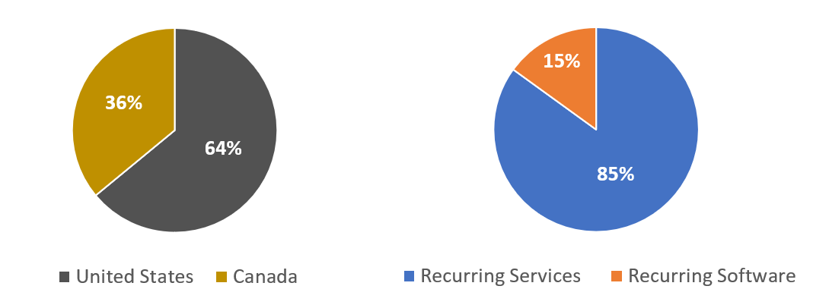
Revenue Mix
Contrarian Investor Virtual Conference | Mon, April 20, 2020

Slide 13
Fortune 1000 Customers / Well Known Brands
35 Fortune 1000 customers and 300 brands
Retail
Food Service & Hospitality
Petro-Convenience
Financial Services
Automotive
Education
Pharmaceutical
Contrarian Investor Virtual Conference | Mon, April 20, 2020

Slide 14
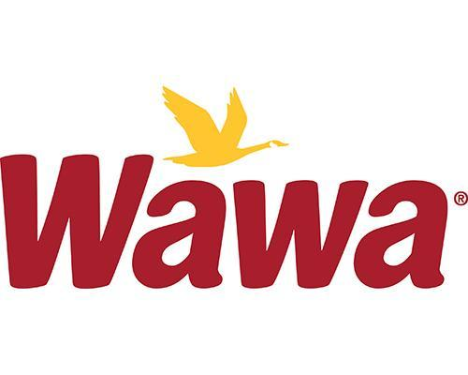
Customers
Contrarian Investor Virtual Conference | Mon, April 20, 2020

Slide 15
Customers
Contrarian Investor Virtual Conference | Mon, April 20, 2020

Slide 16
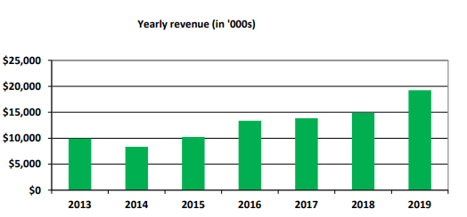
Why I’m Super Bullish: Consistent Revenue Growth
Contrarian Investor Virtual Conference | Mon, April 20, 2020

Slide 17
Why I’m Super Bullish: Growth Accelerating
Strong/Dramatic turn in financials in 2019
Revenue of $19.3M, or 29% growth vs. 2018
Back to profitability
Highest Level of EBITDA since 2013
OPEX as % of revenues went from 70% to 48%
Contrarian Investor Virtual Conference | Mon, April 20, 2020

Slide 18
Why I’m Super Bullish: Strong Balance Sheet, Margins and Cash Flow
~Zero long-term debt
Working Capital: $2.9M, 52% increase over 2018
Current Ratio: 3.2x
Cash : $1.4M at end of 2019 vs 242K in 2018
Operating Cashflow: $1.5M for 2019 vs negative $2.7M in 2018
Gross Margin: 52%
Contrarian Investor Virtual Conference | Mon, April 20, 2020

Slide 19
Why I’m Super Bullish
Recurring Revenue
Recurring/Repeatable Revenues
SaaS
Recurring service revenue is secured by 1 to 3 year contracts
Virtually zero customer attrition since 2013
Contrarian Investor Virtual Conference | Mon, April 20, 2020

Slide 20
Overview Of Why I’m Super Bullish
LiaCX is Game Changer
New customers
Increases wallet share through cross selling opportunities
Increase acquisition opportunities
Contrarian Investor Virtual Conference | Mon, April 20, 2020

Slide 21
Why I’m Super Bullish
Will Survive COVID-19
Fragmented Market
Will lead to accretive acquisitions
Will come out of COVID stronger
Gain market share from weaker competitors
New services to meet demands of “new world”
New COVID related compliance standards/regulation
Experienced CEO
Contrarian Investor Virtual Conference | Mon, April 20, 2020

Slide 22
Industry is Humming
Customers value Insight’s services: Very little customer attrition over the years…
Next to price, customer service is the biggest factor that affects sales conversion, client satisfaction, and brand loyalty. (source: SeeLevel HX)
~90% of customers will just transfer to a competing store if they feel unhappy with the service they receive. (source: SeeLevel HX)
Contrarian Investor Virtual Conference | Mon, April 20, 2020

Slide 23
Industry is Humming
Global market size to reach $23.6 billion by 2027, or a CAGR of 17.7% from 2020 to 2027 (source: Grand View Research)
USA is the largest market, accounting for nearly half of the global market (source: MSPA)
In the U.S. alone, companies spend more than $600 million every year to fund CX (source: SeeLevel HX)
Over two-thirds of CX leaders expect budget increases in 2020 (source: Gartner)
Contrarian Investor Virtual Conference | Mon, April 20, 2020

Slide 24
Post COVID-19 Customer Needs Are Even More Important
source: (Grand View Research)
Contrarian Investor Virtual Conference | Mon, April 20, 2020

Slide 25
Valuation- Priced for Failure or Success?
The right bet at the right price
Company will adapt to COVID-19
Investors have a unique opportunity to buy shares at 60% of where they were trading at two months ago, due to a short-sighted investors
Contrarian Investor Virtual Conference | Mon, April 20, 2020

Slide 26
Valuation vs. Comps
 | MDLA | SVMK | PPRRF (OTC), PFM (CVE) | INSXF
TTM Sales | 402.5 M | $307.4 M | $13.74 M | $19.3 M
Debt | Nil | $213 M | $2.7 M | Nil
EV/TTM Sales | 7.8x | 6.8x | 4.7x | 0.23
Profitable | NO | NO | No | YES
Contrarian Investor Virtual Conference | Mon, April 20, 2020

Slide 27
Valuation Multiples Will Expand
Valuation multiples to expand
Wallet share gains and acquisition opportunities will accelerate SaaS revenue growth over the next 5 years
Investors realize just how sticky the customer base is
Investors will eventually place a much higher valuation on INXSF’s revenues, to the magnitude of 4x to 6x vs. 0.23x, currently
Disclosure: Long INXSF
Contrarian Investor Virtual Conference | Mon, April 20, 2020

Slide 28
Thank You
Maj Soueidan
Founder, GeoInvesting, LLC
geoinvesting.com
Twitter: @majgeoinvesting
maj@geoinvesting.com
Contrarian Investor Virtual Conference | Mon, April 20, 2020

Slide 29
Disclaimer
Please be advised that GeoInvesting™ is a research and publishing firm, of general and regular circulation, which falls within the publisher’s exemption to the definition of an “investment advisor” under Section 202(a)(11)(A) – (E) of the Securities Act (15 U.S.C. 77d(a)(6) (the “Securities Act”). GeoInvesting™ is not registered as an investment advisor under the Securities Act or under any state laws. None of our trading or investing information, including the Content, GeoInvesting™ Email, Executive Casts and/or content or communication (collectively, “Information”) provides individualized trading or investment advice and should not be construed as such. Accordingly, please do not attempt to contact GeoInvesting™, its members, partners, affiliates, employees, consultants and/or hedge funds managed by partners of GeoInvesting™ (collectively, the “GeoInvesting™ Parties”) to request personalized investment advice, which they cannot provide. The Information does not reflect the views or opinions of any other publication or newsletter.
We publish Information regarding certain stocks, options, futures, bonds, derivatives, commodities, currencies and/or other securities (collectively, “Securities”) that we believe may interest our Users. The Information is provided for information purposes only, and GeoInvesting™ is not engaged in rendering investment advice or providing investment-related recommendations, nor does GeoInvesting™ solicit the purchase of or sale of, or offer any, Securities featured by and/or through the GeoInvesting™ Offerings and nothing we do and no element of the GeoInvesting™ Offerings should be construed as such. Without limiting the foregoing, the Information is not intended to be construed as a recommendation to buy, hold or sell any specific Securities, or otherwise invest in any specific Securities. Trading in Securities involves risk and volatility. Past results are not necessarily indicative of future performance.
The Information represents an expression of our opinions, which we have based upon generally available information, field research, inferences and deductions through our due diligence and analytical processes. Due to the fact that opinions and market conditions change over time, opinions made available by and through the GeoInvesting™ Offerings may differ from time-to-time, and varying opinions may also be included in the GeoInvesting™ Offerings simultaneously. To the best of our ability and belief, all Information is accurate and reliable, and has been obtained from public sources that we believe to be accurate and reliable, and who are not insiders or connected persons of the applicable Securities covered or who may otherwise owe any fiduciary duty or duty of confidentiality to the issuer. However, such Information is presented on an “as is,” “as available” basis, without warranty of any kind, whether express or implied. GeoInvesting™ makes no representation, express or implied, as to the accuracy, timeliness or completeness of any such Information or with regard to the results to be obtained from its use. All expressions of opinion are subject to change without notice, and GeoInvesting™ does not undertake to update or supplement any of the Information.
The Information may include, or may be based upon, “Forward-Looking” statements as defined in the Securities Litigation Reform Act of 1995. Forward-Looking statements may convey our expectations or forecasts of future events, and you can identify such statements: (a) because they do not strictly relate to historical or current facts; (b) because they use such words such as “anticipate,” “estimate,” “expect(s),” “project,” “intend,” “plan,” “believe,” “may,” “will,” “should,” “anticipates” or the negative thereof or other similar terms; or (c) because of language used in discussions, broadcasts or trade ideas that involve risks and uncertainties, in connection with a description of potential earnings or financial performance. There exists a variety of risks/uncertainties that may cause actual results to differ from the Forward-Looking statements. We do not assume any obligation to update any Forward-Looking statements whether as a result of new information, future events or otherwise, and such statements are current only as of the date they are made.
Contrarian Investor Virtual Conference | Mon, April 20, 2020

